Slide 1

8th Grade Math: Pre-Algebra
Unit 5, Lesson 6 Pythagorean Theorem Volume 1, pg. 201

Slide 2


Benchmark
MA.8.GR.1.1
Apply the Pythagorean Theorem to solve mathematical and real-world problems involving unknown side lengths in right triangles.
volume 1, pg. 201

Slide 3
Integrated Mathematical Thinking and Reasoning Standards
MA.K12.MTR.1.1 Actively participate in effortful learning both individually and collectively.
MA.K12.MTR.3.1 Complete tasks with mathematical fluency.
MA.K12.MTR.4.1 Engage in discussions that reflect on the mathematical thinking of self and others.
MA.K12.MTR.5.1 Use patterns and structure to help understand and connect mathematical concepts.
volume 1, pg. 201

Slide 4

Learning Targets
I can apply the Pythagorean Theorem to find the hypotenuse of a triangle.
I can apply the Pythagorean Theorem to find the leg of a triangle.
volume 1, pg. 201

Slide 5

Warm-Up
volume 1, pg. 201

Slide 6

5.6.1 Warm-Up: Which One Doesn’t Belong?
Which one doesn’t belong?
A. $3^{2}+b^{2}=5^{2}$
B. $b^{2}=5^{2}−3^{2}$
C. $3^{2}+5^{2}=b^{2}$
D. $3^{2}+4^{2}=5^{2}$
Explain your thinking.
volume 1, pg. 201

Slide 7

Refresher
volume 1, pg. 202

Slide 8


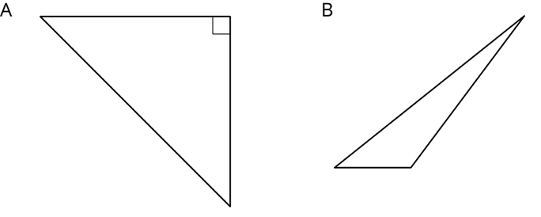
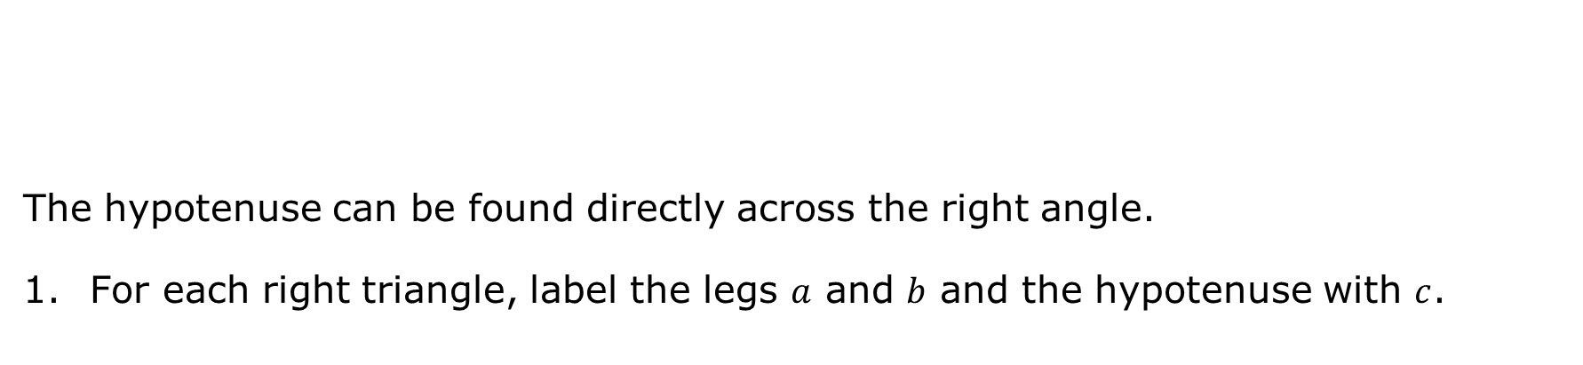
5.6.2 Refresher: Parts of a Right Triangle and Using Square Roots
The hypotenuse can be found directly across the right angle.
For each right triangle, label the legs $a$ and $b$ and the hypotenuse with $c$.
The hypotenuse is the longest side of a right triangle; the side opposite the right angle.
volume 1, pg. 202

Slide 9
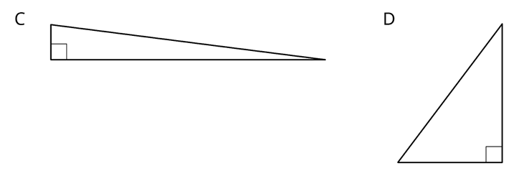
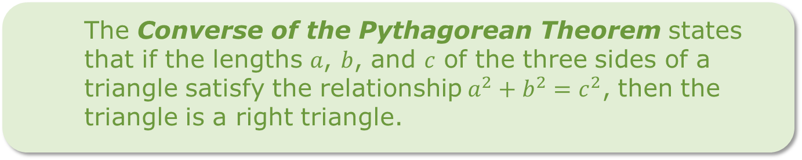
The Converse of the Pythagorean Theorem states that if the lengths 𝑎, 𝑏, and 𝑐 of the three sides of a triangle satisfy the relationship$a^{2}+b^{2}=c^{2}$, then the triangle is a right triangle.
volume 1, pg. 202

Slide 10

Solve for the positive value of the missing variable in each equation. If necessary, approximate your answer.
a. $c^{2}=64$
b. $d^{2}=100+21$
What strategy did you use to find each missing value?
volume 1, pg. 202

Slide 11

Guided Instruction
volume 1, pg. 203

Slide 12
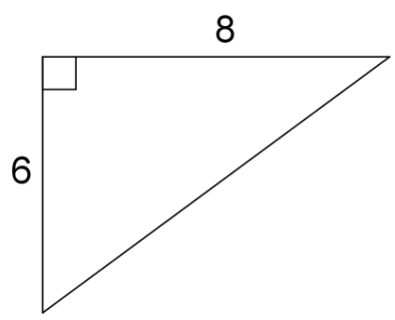
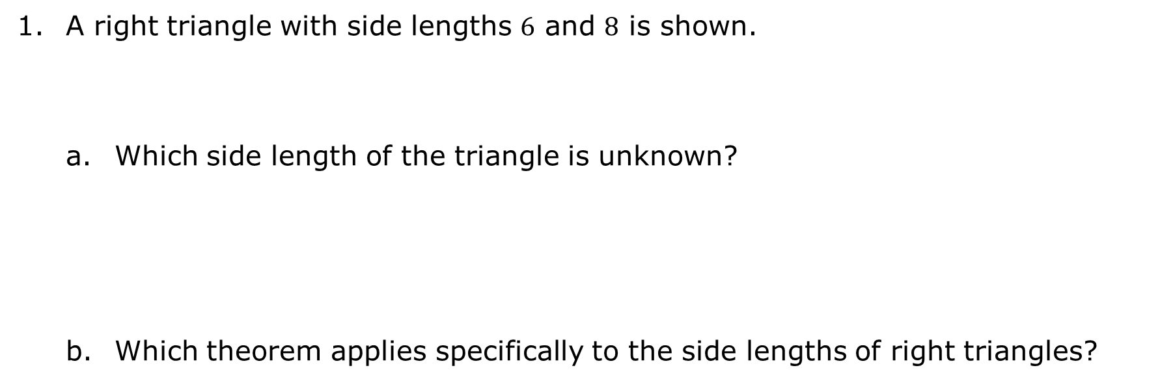
5.6.3 Guided Instruction: Solving for the Hypotenuse Using the Pythagorean Theorem
A right triangle with side lengths $6$ and $8$ is shown.
Which side length of the triangle is unknown?
Which theorem applies specifically to the side lengths of right triangles?
hypotenuse
legs
Pythagorean Theorem
Triangle Inequality Theorem
volume 1, pg. 203

Slide 13
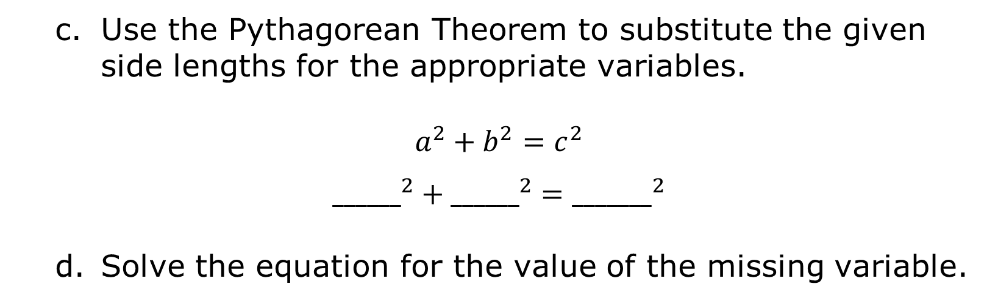
Use the Pythagorean Theorem to substitute the given side lengths for the appropriate variables.
$$a^{2}+b^{2}=c^{2}$$
$${______}^{2}+{______}^{2}={_______}^{2}$$
Solve the equation for the value of the missing variable.
volume 1, pg. 203

Slide 14
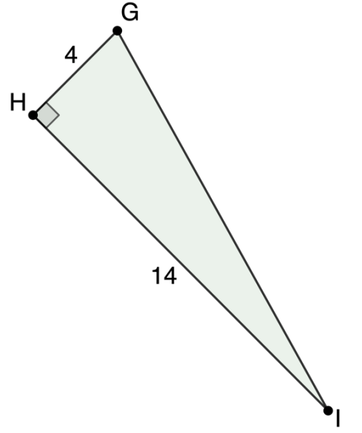
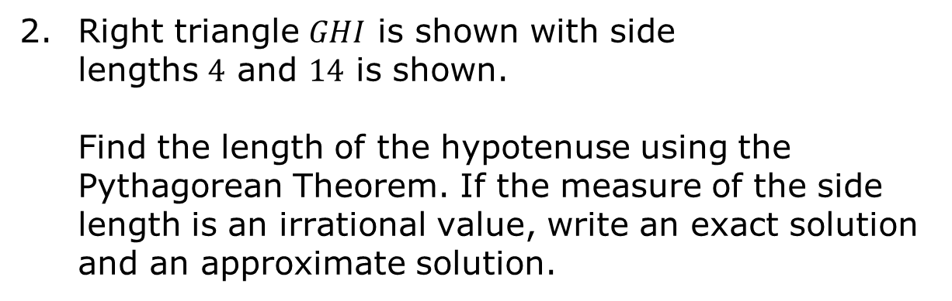
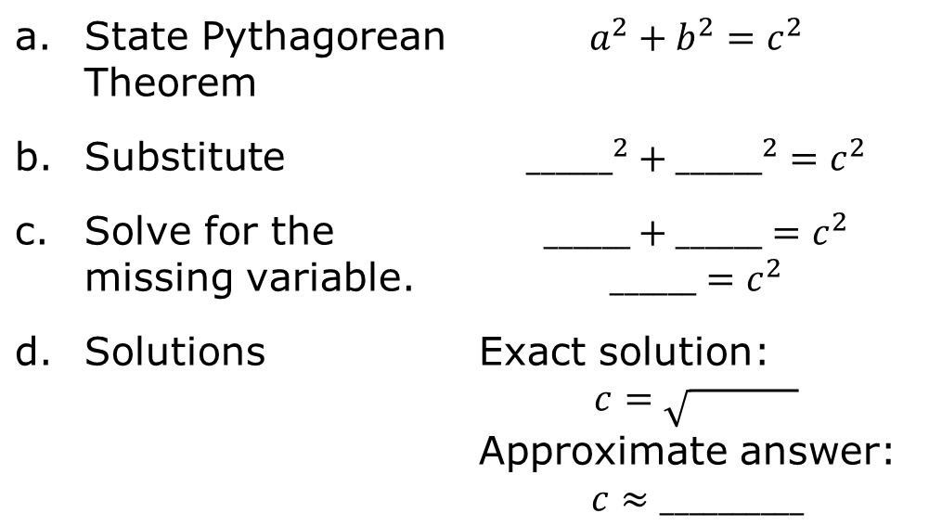
Right triangle $GHI$ is shown with side lengths $4$ and $14$ is shown.
Find the length of the hypotenuse using the Pythagorean Theorem. If the measure of the side length is an irrational value, write an exact solution and an approximate solution.
a. State Pythagorean Theorem | $$a^{2}+b^{2}=c^{2}$$
b. Substitute | $${______}^{2}+{______}^{2}=c^{2}$$
c. Solve for the missing variable. | $$______+______=c^{2}$$ $$______=c^{2}$$
d. Solutions | Exact solution: $$c=\sqrt{ }$$ Approximate answer: $$c≈__________$$
volume 1, pg. 203

Slide 15
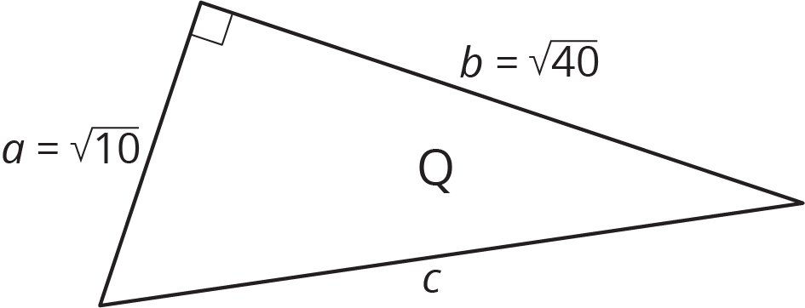
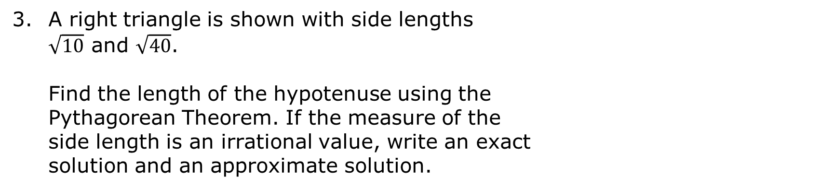
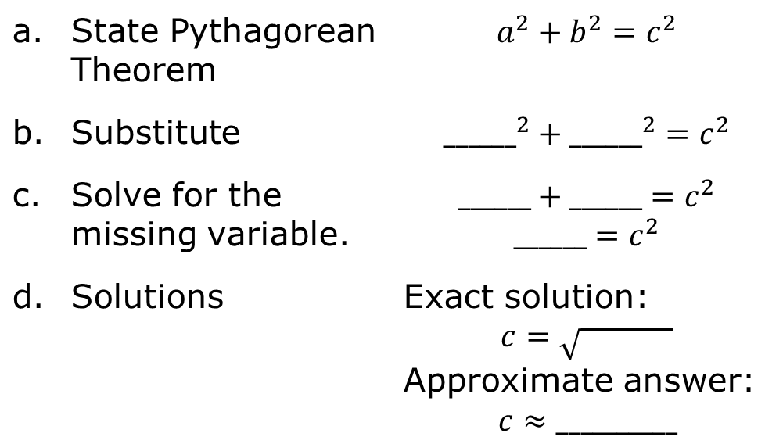
A right triangle is shown with side lengths $\sqrt{10}$ and $\sqrt{40}$.
Find the length of the hypotenuse using the Pythagorean Theorem. If the measure of the side length is an irrational value, write an exact solution and an approximate solution.
a. State Pythagorean Theorem | $$a^{2}+b^{2}=c^{2}$$
b. Substitute | $${______}^{2}+{______}^{2}=c^{2}$$
c. Solve for the missing variable. | $$______+______=c^{2}$$ $$______=c^{2}$$
d. Solutions | Exact solution: $$c=\sqrt{ }$$ Approximate answer: $$c≈__________$$
volume 1, pg. 204

Slide 16

Try It
volume 1, pg. 204

Slide 17

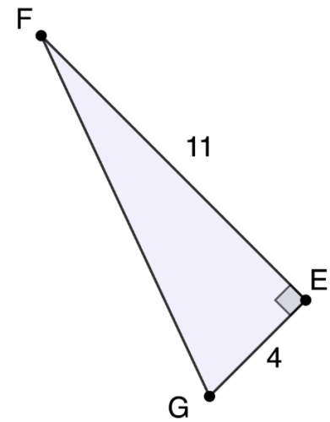

5.6.4 Try It: Finding the Hypotenuse
Right triangle $FEG$ is shown with side lengths $4$ and $11$.
Find the length of the hypotenuse using the Pythagorean Theorem. If the measure of the side length is an irrational value, write an exact solution and an approximate solution.
volume 1, pg. 204

Slide 18

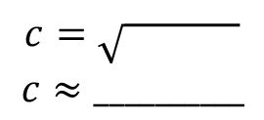
Which side length is unknown?
State Pythagorean Theorem.
Which variable in the equation is unknown?
Substitute values into equation.
Algebraically solve for missing variable.
Solutions
hypotenuse
leg
$a$
$b$
$c$
$$c=\sqrt{ }$$
$$c≈__________$$
volume 1, pg. 204

Slide 19

Collaboration
volume 1, pg. 205

Slide 20

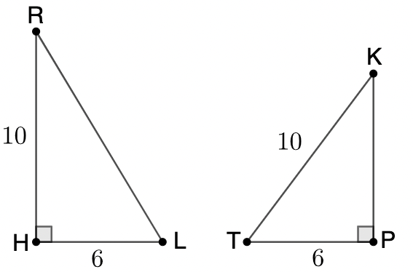
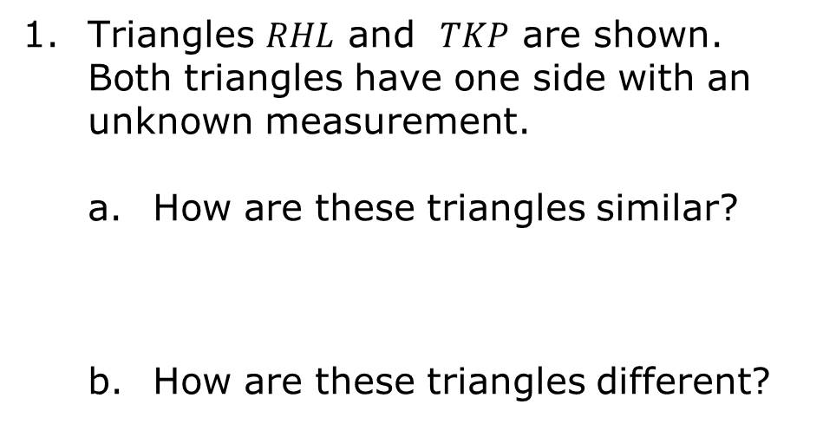
5.6.5 Collaboration: What’s the Leg?
Triangles $RHL$ and $TKP$ are shown. Both triangles have one side with an unknown measurement.
How are these triangles similar?
How are these triangles different?
volume 1, pg. 205

Slide 21
Work with your partner to write equations to determine the length of the missing side in each right triangle using the Pythagorean Theorem.
Triangle RHL | Triangle TKP
volume 1, pg. 205

Slide 22
Guided Instruction
volume 1, pg. 205

Slide 23
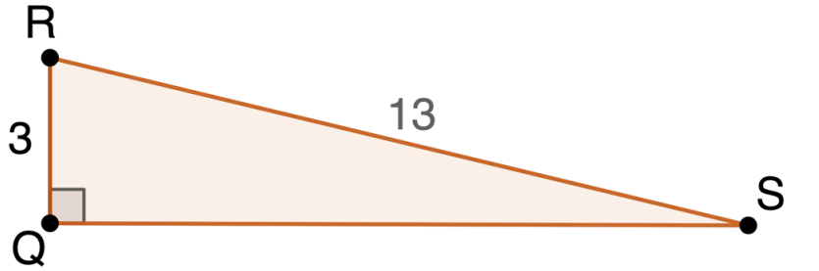

5.6.6 Guided Instruction: Solving for a Missing Leg Using the Pythagorean Theorem
The Pythagorean Theorem can also be used to find a missing leg in a right triangle.
Use the Pythagorean Theorem to find the approximate measure of $\overline{QS}$.
State the Pythagorean Theorem.
volume 1, pg. 205

Slide 24
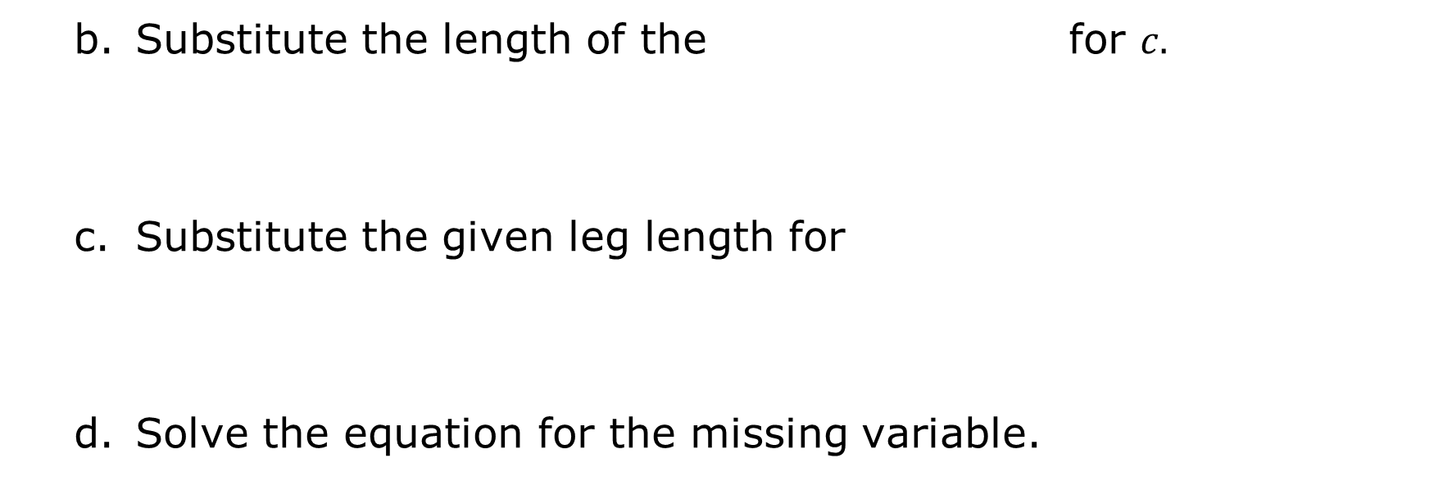
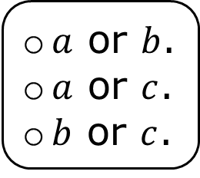
hypotenuse
legs
Substitute the length of the for $c.$
Substitute the given leg length for
Solve the equation for the missing variable.
$a$ or $b$.
$a$ or $c$.
$b$ or $c$.
volume 1, pg. 205

Slide 25
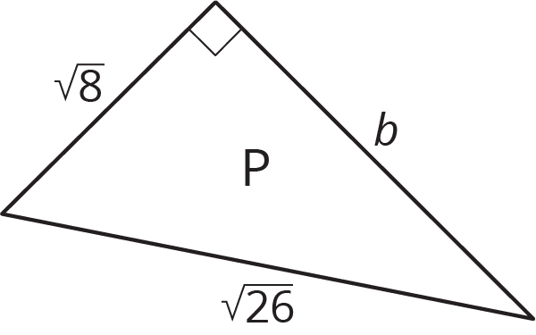

Find the exact measure of $b$ in the diagram.
State the Pythagorean Theorem.
Substitute the length of the for $c.$
hypotenuse
legs
volume 1, pg. 206

Slide 26

Substitute the given leg length for
Solve the equation for the missing variable.
$a$ or $b$.
$a$ or $c$.
$b$ or $c$.
volume 1, pg. 206

Slide 27
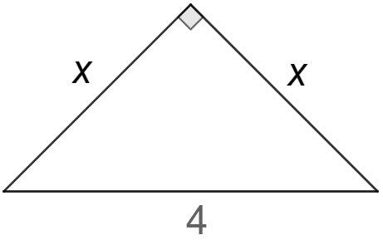

Find the exact length of $x$ in the diagram using the Pythagorean Theorem.
State the Pythagorean Theorem.
Substitute the length of the for $c.$
hypotenuse
legs
volume 1, pg. 206

Slide 28
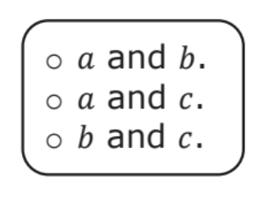
Substitute the given leg length for
Solve the equation for the missing variable.
volume 1, pg. 206

Slide 29

Your Turn
volume 1, pg. 207

Slide 30
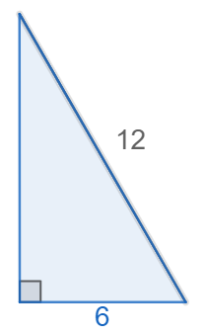
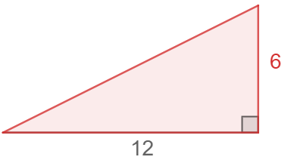
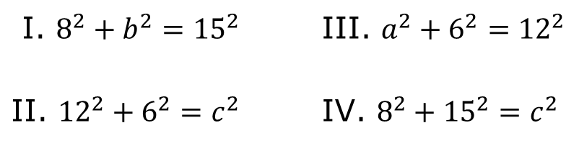
5.6.7 Your Turn!
Match the triangle to the appropriate equation that could be used to solve for the missing side.
_________ B. _________
I. $8^{2}+b^{2}={15}^{2}$ | III. $a^{2}+6^{2}={12}^{2}$
II. ${12}^{2}+6^{2}=c^{2}$ | IV. $8^{2}+{15}^{2}=c^{2}$
volume 1, pg. 207

Slide 31
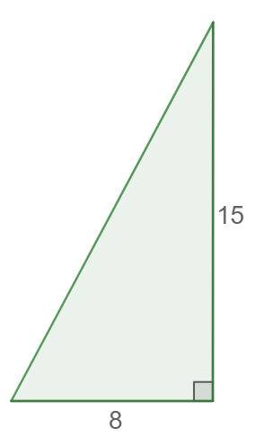
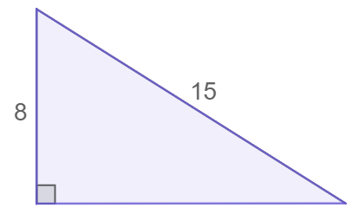
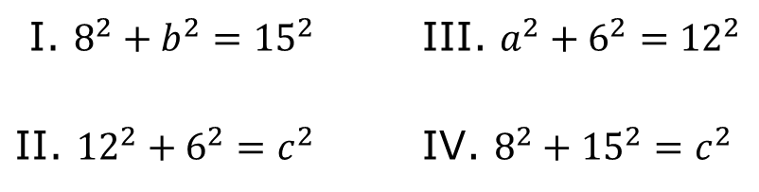
_________ D. _________
I. $8^{2}+b^{2}={15}^{2}$ | III. $a^{2}+6^{2}={12}^{2}$
II. ${12}^{2}+6^{2}=c^{2}$ | IV. $8^{2}+{15}^{2}=c^{2}$
volume 1, pg. 207

Slide 32
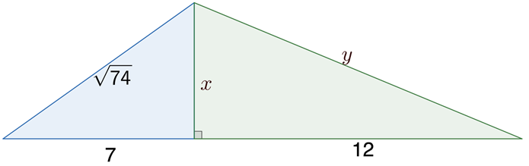
Find the measures of $x$ and $y$ in the diagram using the Pythagorean Theorem.
volume 1, pg. 207

Slide 33

Wrap-Up
volume 1, pg. 208

Slide 34
5.6.8 Wrap-Up: Reflection
Color in the arrow up to the statement which best describes your current understanding.
I’m so confident, I can explain this to someone else!
I can get to the right answer, but I don’t understand well enough to explain it yet.
I understand some of this, but I don’t understand all of it yet.
I tried hard and listened, but I am finding this challenging. I will make sure I get help with this next lesson.
I do not understand any of this yet. There are things I could do to be a better learner next lesson.
volume 1, pg. 208

